Slide 1
TeamNotFound404
FLOOD HACKED

Slide 2
PROBLEM STATEMENT
To optimally distribute food to relief shelters, given limited resources and time
An optimal solution for ensuring an organised distribution of resources during natural calamities such as the recent floods in Kerala.
“Flood Hacked” is a software providing an effective alternative to the existing ad hoc management scheme used by the government during floods.

Slide 3
Machine Learning- Unsupervised Learning
and algorithms
Real time dynamic way of determining the minimum time and number of resources required to maximize the number of people rescued.

Slide 4
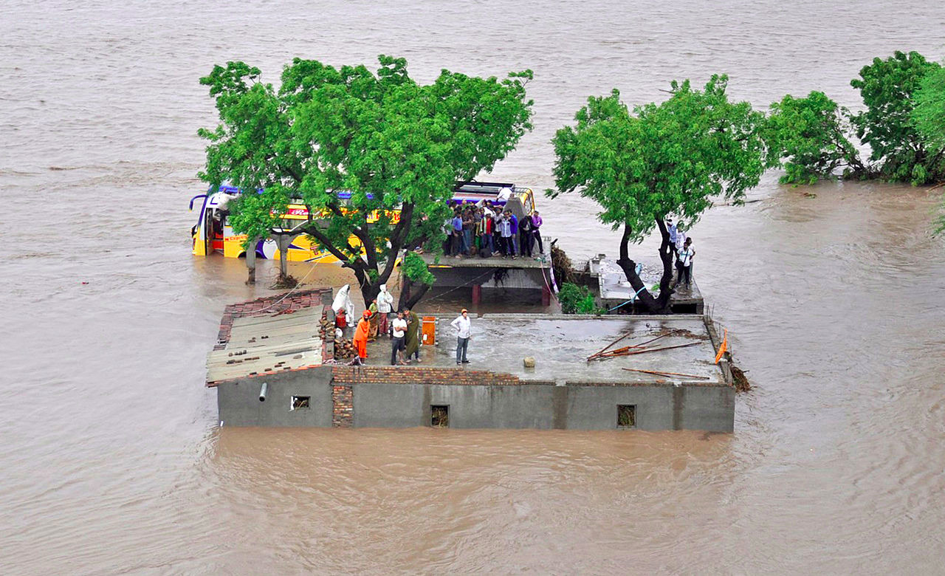
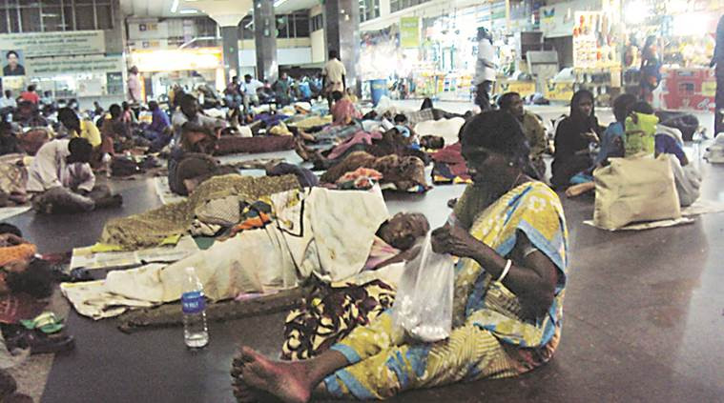
CURRENT GENERAL CALAMITY SCENARIO
80 dams opened, 325 dead, Kerala needs us!

Slide 5
The Idea
Problem:No predetermined information about the current topography
Solution:Using Drones to survey and google maps api to determine
water level
Problem:Determining efficient way of grouping the shelter homes Solution:Using K-means clustering algorithm( unsupervised ML) and allocating drones proportionally as per the size of the cluster.

Slide 6
Problem
Road Vehicles cannot be used.
Helicopters have fuel,capacity,terrain and positioning constraints.
Solution
1) Entire topography consisting of various shelter homes is divided into disconnected clusters each with a central node.
2) Each helicopter launches drones at the nodes which are further responsible for transporting the supplies to the connected shelter homes in that cluster.

Slide 8
